Slide 1

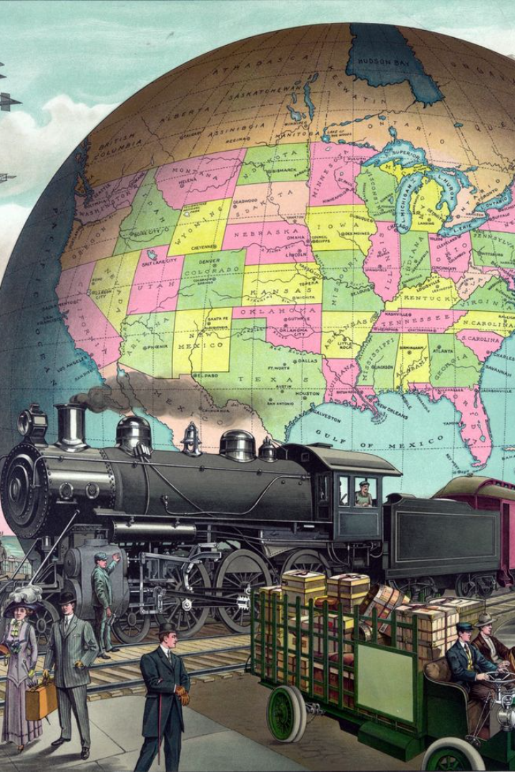
Data Analytics in Travel Planning
Topics covered :
Introduction to the application of data analytics in travel planning.
Overview of the process: Plan, Prepare, Process, Analyze, Share, Act.

Slide 2

Plan
1
Destination Research
Identify potential destinations, duration and budget constraints based on traveler interests, seasonality, and special events.
2
Travel Preferences Survey
Collect data on preferred modes of transportation, accommodation, and activities.
3
Initial Itinerary Draft
Create a preliminary plan based on the collected data and research.

Slide 3
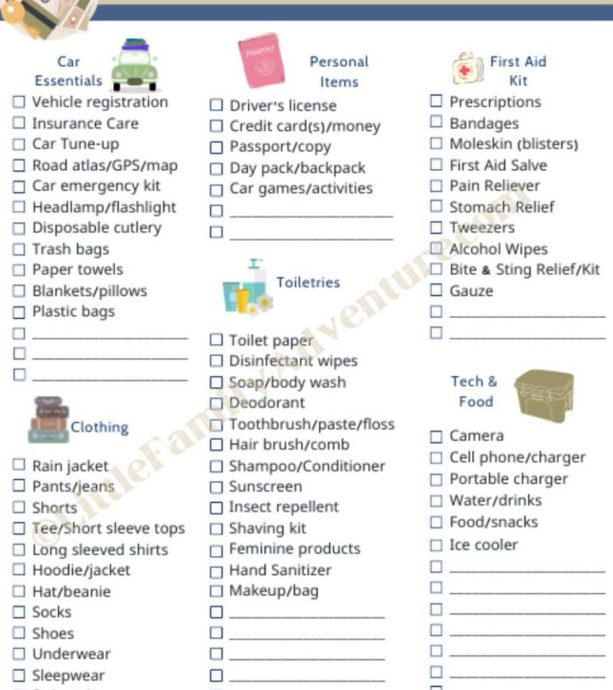
Prepare
Travel Document Verification
Gathering necessary resources for trip planning.
Researching
Researching transportation options (flights, trains, buses) and accommodations (hotels, Airbnb, etc.).
Health and Safety Precautions
Research and prepare for any health or safety precautions relevant to the chosen destination.

Slide 4




Process
Evaluating preferences and interests for activities during the trip.
Analyzing data on tourist attractions, local cuisine, and cultural experiences.
Comparing prices and reviews of various travel services and accommodations

Slide 5

Analyse
1
Trend Identification
2
Analyzing patterns
3
Considering reviews
Analyzing weather forecasts and tourist crowd patterns.
Assessing travel trends and seasonal factors.
Considering factors such as safety ratings and traveler reviews.

Slide 6

Share
Communicating travel plans and preferences with travel companions.
Seeking recommendations and advice from friends, family, or online communities.

Slide 7



Act
Making the final booking decisions based on the analysis.
Booking flights, accommodations, and any necessary activities or tours.

Slide 8

Thank you

